Slide 1
NEIL GOGTE INSTITUTE OF TECHNOLOGY & KESHAV MEMORIAL ENGINEERING COLLEGE
ARTIFICIAL INTELLIGENCE
(PC 502CSM)
Deepika.M
Assistant Professor, CSE(AIML)
NGIT

Slide 2


Slide 3
UNIT-IV Learning DECISION TREES

Slide 4

Gini index
The Gini index measures impurity or inequality frequently used in decision tree algorithms.
It quantifies the probability of misclassifying a randomly chosen element if it were randomly labeled according to the distribution of labels in a particular node.
The equation for the Gini index is as follows:
where p1​, p2​, ..., pk​ are the probabilities of each class in the node.

Slide 5
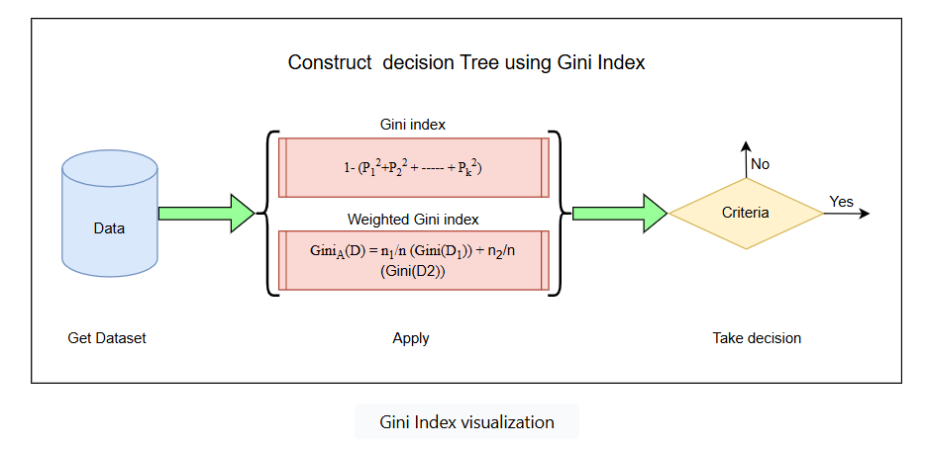

Slide 6
The GiniA​(D) represents the weighted Gini index for the entire dataset D. It's a measure of impurity or inequality in the dataset, considering the weighted average of the impurities of two subsets, D1​ and D2​.
n1​: This is the number of instances (data points) in subset D1​.
n2​: This is the number of instances (data points) in subset D2​.
n: The total number of instances in the entire dataset D(n=n1+n2).
Gini(D1​): This is the Gini index of subset D1​, which quantifies the impurity or uncertainty of class labels in D1. A lower Gini index indicates higher purity.
Gini(D2​): This is the Gini index of subset D2​, similar to Gini(D1)Gini(D1​), but for the other subset.

Slide 7
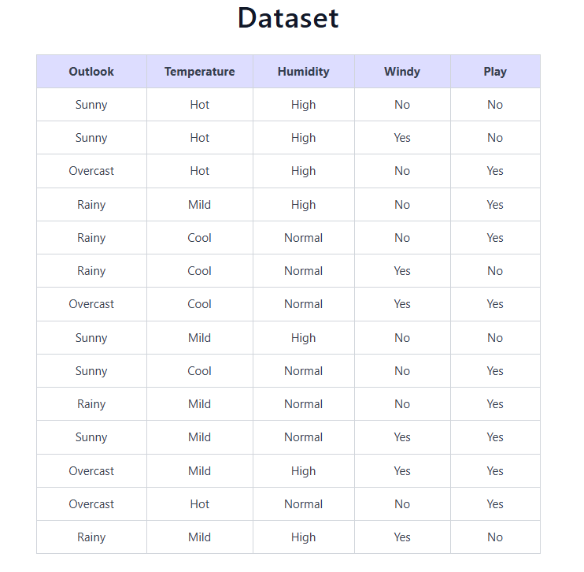

Slide 8
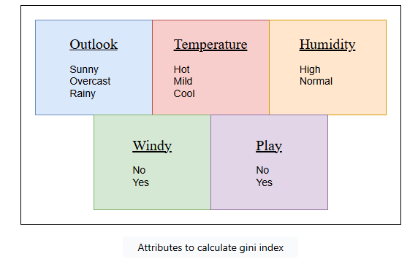
To calculate the Gini index for each attribute and construct a decision tree, we'll start by analyzing the given data and calculating the Gini index for each attribute at the first step. We have four attributes in the above dataset:

Slide 9
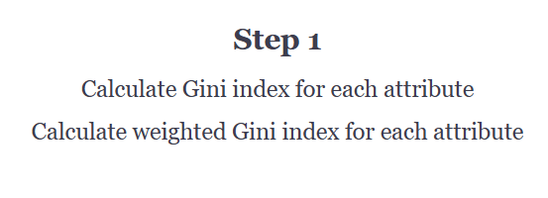
Steps to construct a decision tree

Slide 10

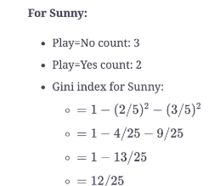
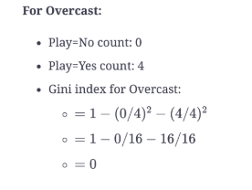
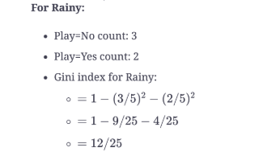


Slide 11
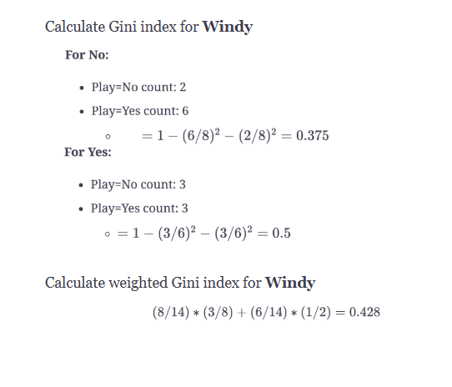

Slide 12
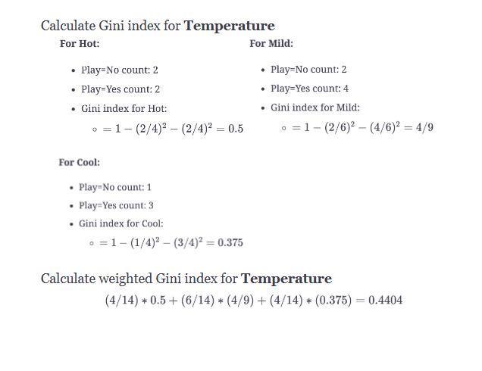

Slide 13
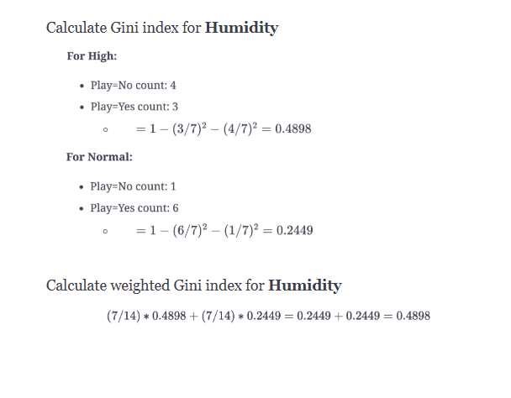

Slide 14
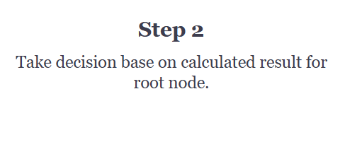

Slide 15
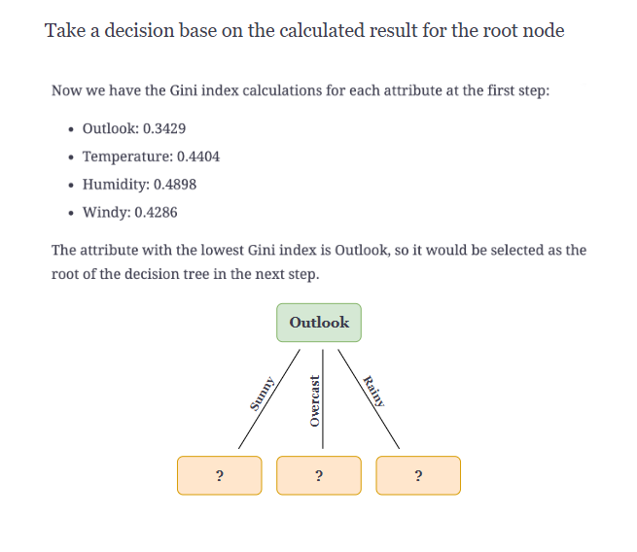

Slide 16
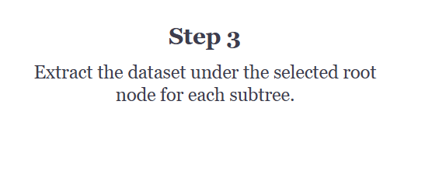

Slide 17
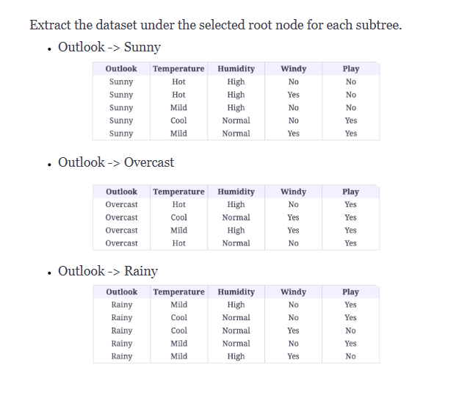

Slide 18
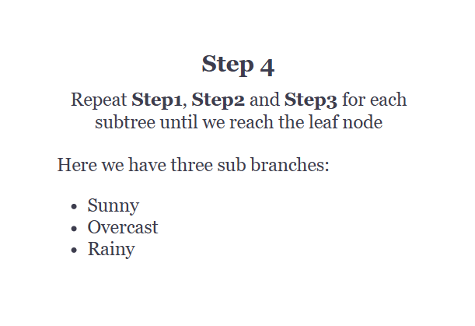

Slide 19
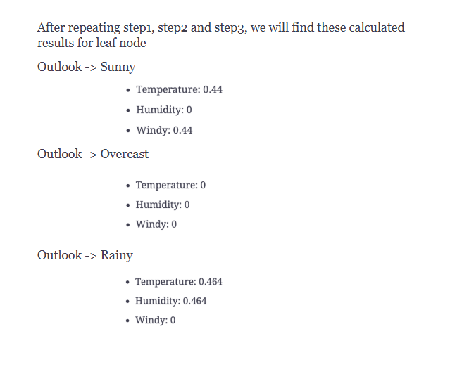

Slide 20
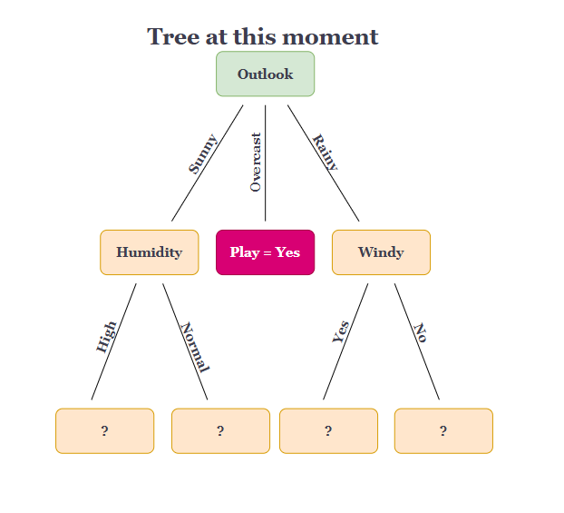

Slide 21
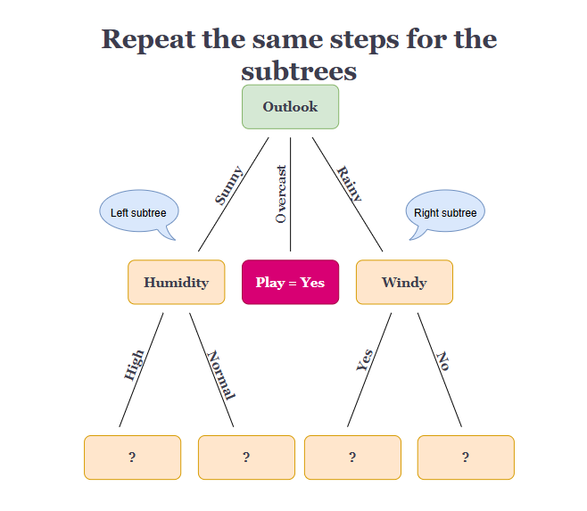

Slide 22
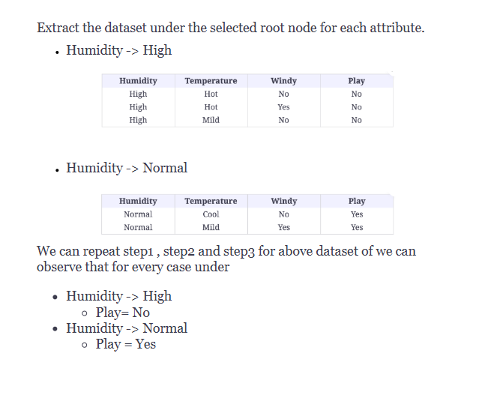

Slide 23
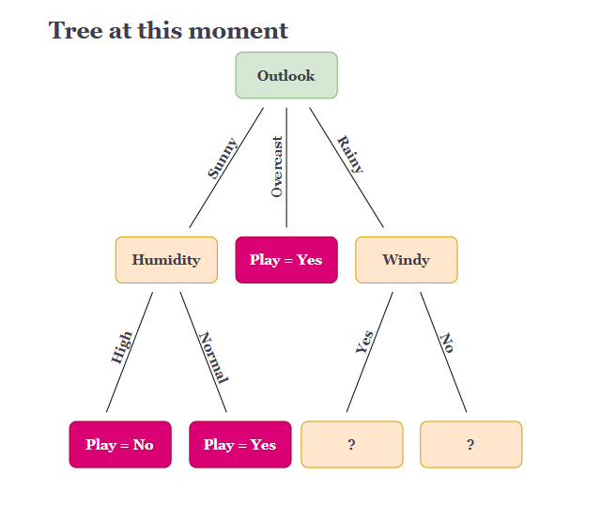

Slide 24
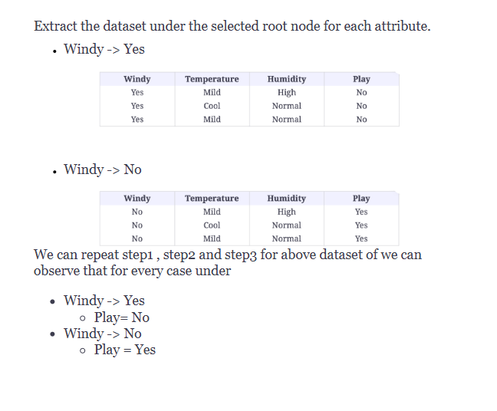

Slide 25
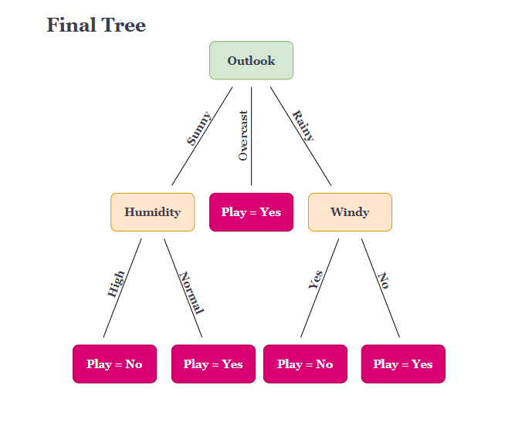

Slide 26
By leveraging the Gini index, which measures the impurity of a node, we were able to determine the best splitting criteria for creating an effective decision tree model.
This approach allowed us to make informed decisions based on the purity and predictive power of each node in the tree.
The Gini index offers a valuable tool for decision tree construction, enabling us to efficiently handle categorical and numerical features.

Slide 27


